Slide 1

What does assessment (even) have to do with equity?
Natasha Jankowski, Executive Director of the National Institute for Learning Outcomes Assessment (NILOA), and Associate Professor, UIUC

Slide 2

National Institute for Learning
Outcomes Assessment (NILOA)
NILOA is a research and resource-development organization dedicated to documenting, advocating, and facilitating the systematic use of learning outcomes assessment to improve student learning.
Publications
Surveys and Case Studies
Focus Groups and Interviews
Assignment Design and Library
Equity and Assessment
Transparency Framework
Evidence-Based Storytelling
Mapping Learning
Tookits
Notes:
Quick intro to NILOA

Slide 3
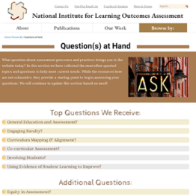
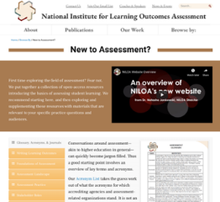
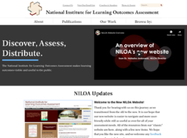
www.LearningOutcomesAssessment.org
Notes:
Website – learningoutcomesassessment.org
Assessment modules
Assessment brief and audiences
Join our email list – once a month newsletter

Slide 4
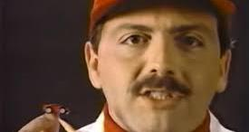
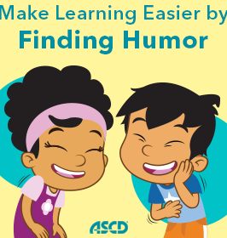


Slide 5

Our Time Together This Morning
- Define assessment
- Explore equity and assessment
- Discover more resources than you want
- Ask questions as we go along in the chat (Kara will step in and alert me if we need to go back over anything)
- Link to the PPT deck is in the chat
- All the resources are linked and embedded in the slide deck
- Please be gracious with one another

Slide 6


Slide 7
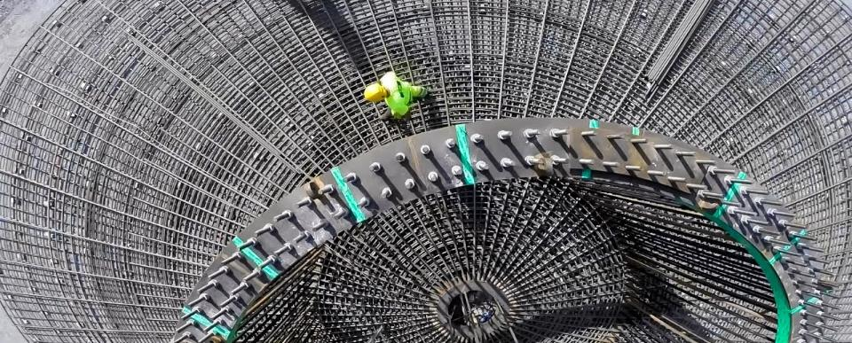
Foundations and Basics: Defining Assessment

Slide 8
Definition
Assessment of student learning involves the systematic collection, review, and use of information about educational programs/courses/ experience undertaken for the purpose of improving student learning and development.
It does not mean testing or grading only
It is a discipline and scholarship
It is not only done because someone said we had to
Notes:
Begin with some definitions on what assessment is to help guide the rest of our time together

Slide 9
Evidentiary Reasoning
“Educational assessment is at heart an exercise in evidentiary reasoning. From a handful of things that students say, do, or make, we want to draw inferences about what they know, can do, or have accomplished more broadly.” (Mislevy & Riconscente, 2005, p. iv).
Put more simply it’s a way to justify stated beliefs about students and their learning as well as the role of our institutions and programs in getting them there.
Notes:
This means it is part of our belief system – so beliefs and philosophies and mind sets guide the structure of what we do and how we do it and what we look at regarding student learning or what we don’t – it because about evidence and design.

Slide 10
Ask yourself:
What do you want to know about x?
What argument do you want to make about x?
What type of evidence would be necessary to make that argument?
Notes:
If about evidentiary arguments – then Toulmin argumentation model can be of use.

Slide 11
Philosophy or Lens
How we see this work impacts what we see, how we define the issues, how we solve for them, and how we develop models to address the issues. It also means there are implications for where and how equity fits into assessment processes and practices.
Notes:
But that also means that we need to examine our philosophies

Slide 12
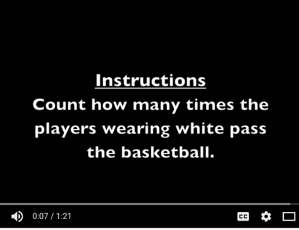
Selective Attention Test
This is a picture of a video…sorry
https://www.youtube.com/watch?v=vJG698U2Mvo
Notes:
In essence, they are ways of seeing and hence ways of not seeing other things.

Slide 13
Measurement
Built upon scientific principles or empirical research, objective, rational, validity, and reliability
  Testing and standardization
  Must be measurable
  Argue narrowing of curriculum
  Goal driven
  Focused on process
  Interventions
  Pre/post
  Comparisons
Equity is in disaggregation, same measures, and measure fairness
Notes:
Yeah that sounds great, but your n is too small
Sure these results could be actionable, but how did you collect the datat?
Folks that think assessment is about testing
Standardization
Also belief that if we get a process in place it will somehow protect us, follow the process and we will be ok – as an end in itself

Slide 14
Compliance
Documenting institutional quality assurance through reporting frameworks
Is assessment destroying the liberal arts? ~Karin Brown
  Bureaucratic
  Laborious
  Time consuming
  Separated from teaching and learning
  Add on
  Accountability and quality assurance
  Reporting and archive
  Lots of data collection, minimal use

Slide 15
Write Outcomes
Identify Assessments
Gather Results
Package Results
Submit Reports
ACCREDITATION/ PROGRAM REVIEW
Equity is a box on the report or an additional question
Notes:
Our reports rarely have a specific audience

Slide 16

But where are the students and what does this have to do with my teaching?

Slide 17
Teaching and Learning
Focus on pedagogy, understanding of student experience, informing program improvement, embedded in curricular design and feedback, builds student agency
  Driven by faculty questions regarding their praxis – is what I am doing working for my students?
  Improvement oriented
  Focus on relationship between teaching and learning
  Formative
  Feedback
  Adaptive and embedded
Equity is in the examination of practices and differential relationship to learning
Notes:
A view with learning in mind is that of teaching and learning - this is about interrogating our own practice and its relationship with learning

Slide 18

Student-Centered
Focused on the student and their individual learning, self-reflection, and transference of learning.
  Co-create assignments
  Joint Problem Solving with Student
  Shift in power differential
  Students put forward demonstrations of their learning
  Students are aware of and understand the curriculum intent and structure
  Language in learning outcomes is student friendly
  Assessment for Learning

Slide 19
Name Expectations for Learning
Communicate Expectations to Learners
Collect Student Work
Determine Extent of Learning
Strategize New Student Success Plans
Equity becomes about transparency in design and student agency
IMPROVEMENT/ STUDENT SUCCESS

Slide 20
Philosophies of Assessment
Teaching and Learning
Measurement
Compliance/Reporting
Student-Centered
https://www.learningoutcomesassessment.org/wp-content/uploads/2020/05/Philosophy-Activity.pdf
Notes:
So – what are the lenses at play in your work here – this is an activity taken from Nan Traver’s work on PLA to help us explore and figure it out

Slide 21
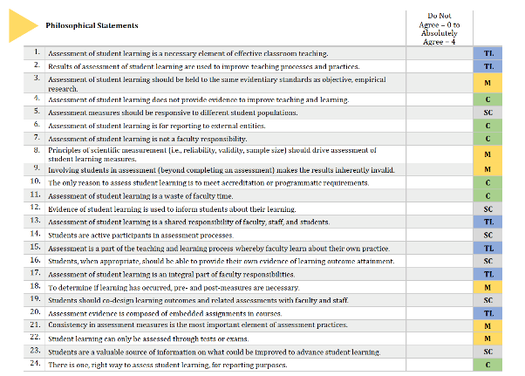
Notes:
Go ahead and first, go through and complete the form yourself and tally up yours Add up numbers to see where you fall in the groupings and talk about how unlikely will be in only one It is 0-4, N/A is 0, you can do .3 or whatever but you have to add at the end

Slide 22
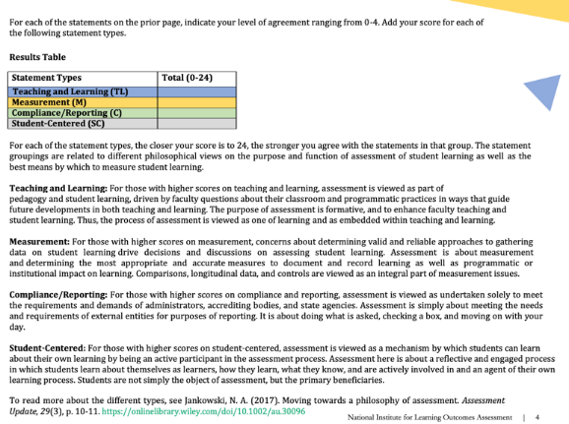
Notes:
Are there ways you think about assessment that aren’t on this list or in these groupings? Share those out

Slide 23
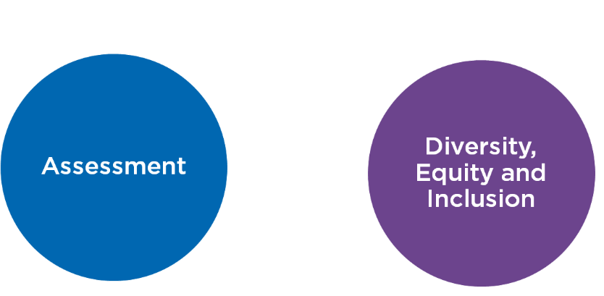
Notes:
Anne

Slide 24
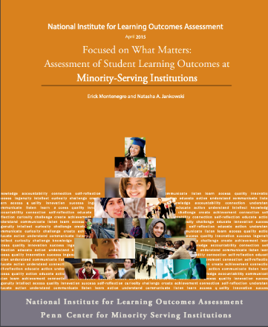
MSI report

Slide 25
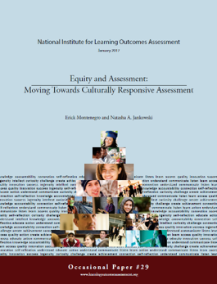
Equity Conversation Overview
Our student population is increasingly diverse
We know that in other areas of the institution, support needs differ by student populations
We don’t talk about it in assessment
We equate fairness with equity and limit the types of learning demonstrations we accept related to learning outcomes
Equity of process or equity of results?

Slide 26
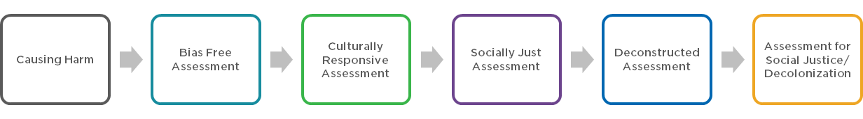
Equity Discussions
Notes:
But, before we get into discussions on the readings we need to do a bit of level setting- so there are a wide range of equity discussions

Slide 27
WHAT DOES “EQUITY-MINDED ASSESSMENT” ENTAIL?
Check
Check biases and ask reflective questions throughout the assessment process to address assumptions and positions of privilege
Use
Use multiple sources of evidence appropriate for the students being assessed and assessment effort
Include
Include student perspectives and take action based on perspectives
Increase
Increase transparency in assessment results and actions taken
Ensure
Ensure collected data are meaningfully disaggregated and interrogated
Make
Make evidence-based changes that address issues of equity that are context specific

Slide 28
Equitable Assessment
At its core, equitable assessment calls for those who lead and participate in assessment activities to pay attention and be conscious of how assessment can either feed into cycles that perpetuate inequities or can serve to bring more equity into higher education.

Slide 29

Infusing Equity in Assessment

Slide 30
Equity and Assessment
Process Implemented
Doing of the Process
Methods
Analysis
Policies
Decision Making
Action
Notes:
And equity and assessment is being examined in every facet of the assessment process

Slide 31

What would assessment look like if it was a vehicle for equity?
Notes:
Leading to the current national discussion on what assessment could look like as a vehicle for equity

Slide 32
Transparency in Assignments
Transparency in Learning and Teaching: https://tilthighered.com/
Purpose
Skills you’ll practice by doing this assignment
Content knowledge you’ll gain from doing this assignment
How you can use these in your life beyond the context of this course, in and beyond college
Task
What to do
How to do it (Are there recommended steps? What roadblocks/mistakes should you avoid?)
Criteria
(Are you on the right track? How to know you’re doing what’s expected?)
Annotated examples of successful work
(What’s good about these examples? Use the checklist to identify the successful parts.)
Notes:
How does this relate to equity – the point about having people be told that their learning doesn’t count over time in every course is a great way to lost students, but also, transparency in design closes equity gaps

Slide 33
Questions for Assignment
What learning outcomes will students demonstrate with this assignment? How does it need to be modified to better align with the learning outcomes of interest?
How does the assignment align with the evaluative criteria? Are there mixed signals sent to students?
Thinking about the assignment from the point of view of students, what questions or suggestions do you have?
How does this assignment allow for flexible options, alternative demonstrations, and/or culturally responsive demonstrations of learning?
How does this assignment need to be modified or adjusted to reflect current faculty and student circumstances and situations?
What unnecessary constraints, if any, may need to be removed to accommodate learning in a global pandemic crisis?
Notes:
Focused on questions – and can include a focus on equity questions in assignments

Slide 34
Having Hard Talks
How ought we assess to be responsive to minority students?
How do we think about our responsibility for minority student outcomes?
How do we think about equity?
How do we know who benefits from the initiatives, innovations, and programs that we are so proud of?
How do the assumptions we make about our students disadvantage them?
How do best practices take race and equity into account?
~Bensimon, 2012

Slide 35

Assumptions
Most of the standardized measures and theories we utilize come from studies of white students in mostly white institutions
We value certain demonstrations of learning over others, and in this way, we limit student demonstrations and privilege certain approaches.
We do not value narrative or personal experience in the same way for institutional decision making as we do quantitative data.
Our students are experts of their own experience.

Slide 36
Foundational Assumptions
If we do equity work in assessment, assessment is positioned squarely out of the compliance box
Higher education as an enterprise has been and continues to be, a product of social construction (Harrison & Price, 2017)
Everyone has limiting higher education narratives – limiting to our ability to make changes – because of which students we think can be successful where and in what ways.

Slide 37
Interacting with Data

Slide 38
Definition
“Stereotypes, omissions, and distortions all contribute to the development of prejudice. Prejudice is a preconceived judgment or opinion, usually based on limited information. I assume that we all have prejudices, not because we want them, but simply because we are so continually exposed to misinformation about others.” (Tatum, 1997, p. 5)

Slide 39

Resources

Slide 40
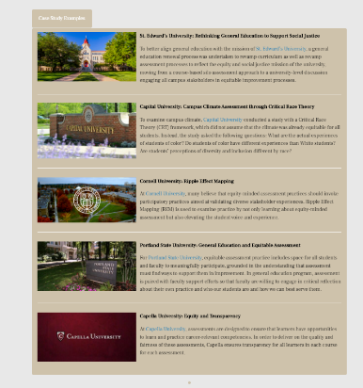
Notes:
There are institutional examples of how equity and assessment is currently being examined– and of note, they had to define what equitable assessment looked like for that institution - which requires a different lens on assessment – not one of compliance, of simply measurement and disaggregating data. So want to kick off with a brief primer on a definition of assessment and four philosophies of assessment.
Equity cases…responses, conversation on equity and assessment – more than just disaggregation – which is why we need to open with re-examining assessment as a collaborative act as infused in our culture with a growth mindset

Slide 41
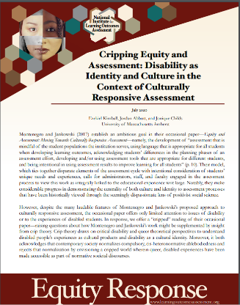

Slide 43
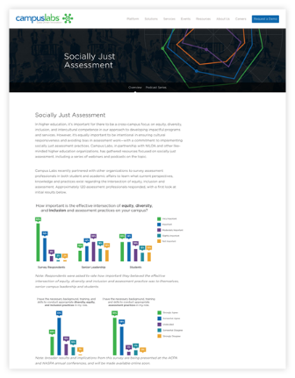
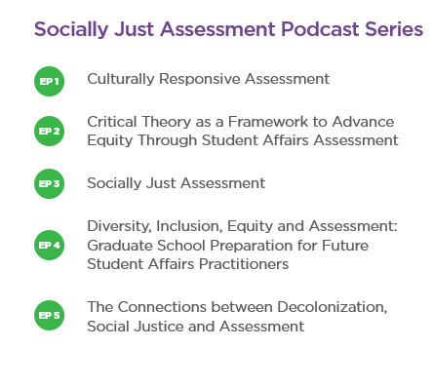
Notes:
Anne can speak to this

Slide 44

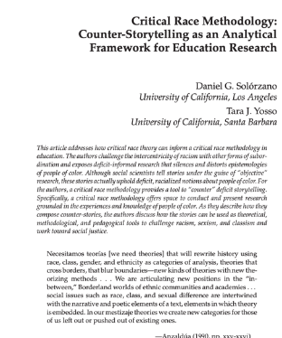
Reminders and Counter-Narratives

Slide 45
Equity Scorecard
https://cue.usc.edu/tools/the-equity-scorecard/

Slide 46
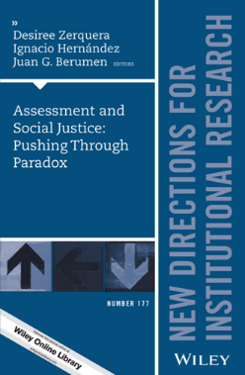
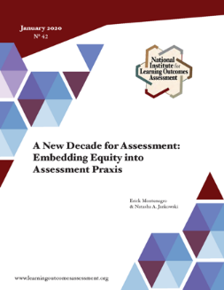
Notes:
Two pre-readings to frame the conversation and get the thinking going – and if you want more there is the journal issue as well

Slide 47

Otter Ideas and Questions?

