Slide 1
Promoting Equity and Engagement: Actively Involving Students in Assessment
Natasha Jankowski, NILOA and UIUC
Korana Burke, UC Davis

Slide 2
Equity and Assessment
Student Roles
Assessment is not something we do to students it is something we do with students.
As a researcher
Think aloud on assignment intent
Co-create rubric
Design assignment
Write a letter to an incoming student on what they wished they knew or someone had told them
Validate that their learning matters
Notes:
There are many ways to show you know how to do something – why do only some demonstrations count in certain instances? Validates our students as learners – validates them Build from daily work of faculty in assignment, and culturally responsive assessment – equity lens added to it Help faculty understand the diversity in front of them Classroom teaching strategies as it relates to equity and diversity and advising lens – assignment think aloud Have students be active researchers – but if assessment is about measurement – these aren’t options and if it is about reporting they aren’t options either

Slide 3
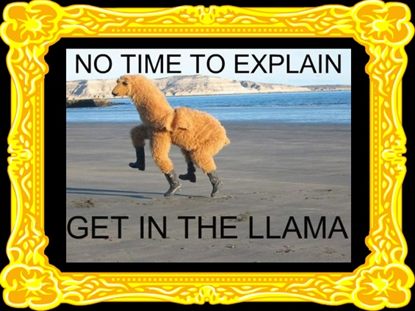
Student-Centered
Share the learning outcomes and their relevancy
Actively engage in reflection and transference
Undergraduate research – a High-Impact Practice: https://www.learningoutcomesassessment.org/wp-content/uploads/2020/03/AiP-Turos.pdf

Slide 4
Spectrum of Student Involvement
Decide what to change for others
Check in with students to see if they agree with final product
Students lead on identifying issues and solutions
Student as object of assessment
Student Representation on Committee
Examine student differences through data disaggregation
Blame Student for Differences
Examine Organizational Structures
Survey Students or Focus Groups

Slide 5
What we hear about student involvement…
What could students tell us that we don’t already know?
We already have a student on the committee.
We don’t have capacity or the time for such things.
Students barely engage in coursework, why would they engage in assessment?
Involving students in assessment delegitimizes, devalues, and invalidates the assessment process and data gathered.
Nobody cares about our students more than me, but, honestly, students don’t know what assessment is. They barely know what they want from their education. We know what is best for students.

Slide 6
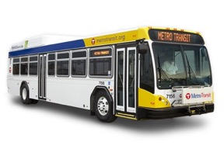
But students say…

Slide 7
Research says…
As Pastore and Pentassuglia (2015) state, “assessment is a ‘silent practice’, closed and not shared with students: a silent assessment that loses its empowerment and formative chance both for teachers and for students” (p. 418).
Reinforces sense of belonging (Boud, 2017); engages in deeper lasting learning (Martens, Spruijt, Wolfhagen, Whittingham, & Dolmans, 2019).
Students have perceptions and beliefs about assessment – they come from K-12 or work, they have experienced it differently (Sambell, McDowell, & Brown, 1997).
It begins with the concept that if students know what is expected of them, they will meet or exceed those expectations better than if they have to guess what they might be (Falchikov, 2005).
If assessment is about enhancing student learning as opposed to simply documenting it, then involving students is a vital approach to ensuring learning occurs (Brown, 2017).

Slide 8
What are we assessing?
Effort?
Privilege?
The Learning?
Cultural Capital?

Slide 9
Notes:
Equity – student population – careful with mappng for part-time, non-traditional, can’t experience it way designed
High impact practice to involve in undergraduate research

Slide 10
Student Involvement

Slide 11
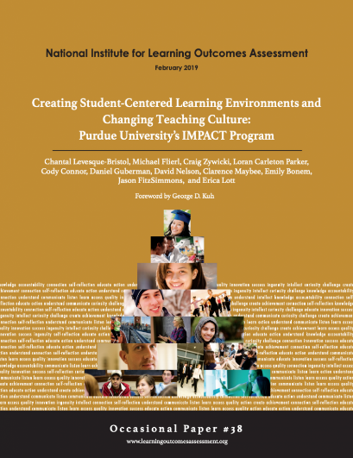
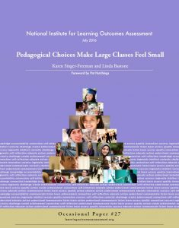

Slide 12
https://www.confederationcollege.ca/tlc/indigenous-learning-outcomes

Slide 13
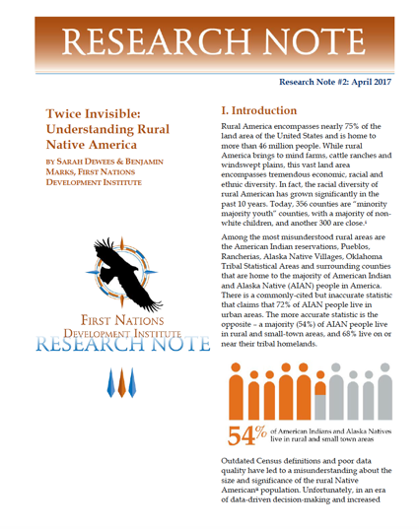

Slide 15
New Book on the topic….Coming soon from Peter Lang

