Slide 2
Equity Minded Assessment: Webinar and Community Discussion
Natasha Jankowski, Executive Director of the National Institute for Learning Outcomes Assessment (NILOA), and Associate Professor, UIUC

Slide 3
National Institute for Learning Outcomes Assessment (NILOA)
NILOA is a research and resource-development organization dedicated to documenting, advocating, and facilitating the systematic use of learning outcomes assessment to improve student learning.
Publications Surveys and Case Studies Focus Groups and Interviews Assignment Design and Library Equity and Assessment Transparency Framework Evidence-Based Storytelling Mapping Learning Tookits
Notes:
Quick intro to NILOA

Slide 4
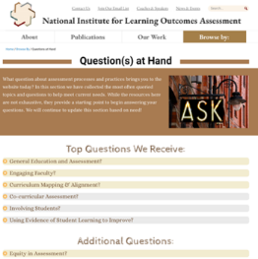
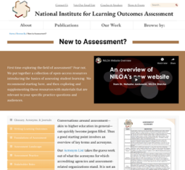
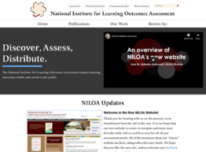
www.LearningOutcomesAssessment.org
Notes:
Website – learningoutcomesassessment.org
Assessment modules
Assessment brief and audiences
Join our email list – once a month newsletter

Slide 5
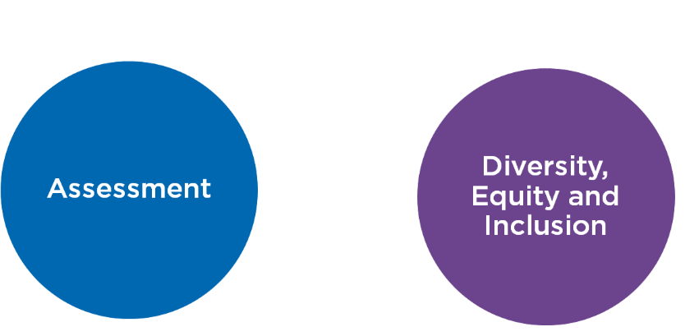
Notes:
Anne

Slide 6
Definition
Assessment of student learning involves the systematic collection, review, and use of information about educational programs/courses/ experience undertaken for the purpose of improving student learning and development.
It does not mean testing or grading only
It is a discipline and scholarship
It is not only done because someone said we had to
Notes:
Begin with some definitions on what assessment is to help guide the rest of our time together

Slide 7
Evidentiary Reasoning
“Educational assessment is at heart an exercise in evidentiary reasoning. From a handful of things that students say, do, or make, we want to draw inferences about what they know, can do, or have accomplished more broadly.” (Mislevy & Riconscente, 2005, p. iv).
Put more simply it’s a way to justify stated beliefs about students and their learning as well as the role of our institutions and programs in getting them there.
Notes:
This means it is part of our belief system – so beliefs and philosophies and mind sets guide the structure of what we do and how we do it and what we look at regarding student learning or what we don’t – it because about evidence and design.

Slide 8
Measurement
Built upon scientific principles or empirical research, objective, rational, validity, and reliability
Testing and standardization
Must be measurable
Argue narrowing of curriculum
Goal driven
Focused on process
Interventions
Pre/post
Comparisons
Equity is in disaggregation, same measures, and measure fairness
Notes:
Yeah that sounds great, but your n is too small
Sure these results could be actionable, but how did you collect the datat?
Folks that think assessment is about testing
Standardization
Also belief that if we get a process in place it will somehow protect us, follow the process and we will be ok – as an end in itself

Slide 9
Compliance
Documenting institutional quality assurance through reporting frameworks
Is assessment destroying the liberal arts? ~Karin Brown
Bureaucratic
Laborious
Time consuming
Separated from teaching and learning
Add on
Accountability and quality assurance
Reporting and archive
Lots of data collection, minimal use

Slide 10
Write Outcomes
Identify Assessments
Gather Results
Package Results
Submit Reports
ACCREDITATION/ PROGRAM REVIEW
Equity is a box on the report or an additional question
Notes:
Our reports rarely have a specific audience

Slide 11
But where are the students and what does this have to do with my teaching?

Slide 12
Teaching and Learning
Focus on programming, understanding of student experience, informing program/unit improvement, embedded in co-curricular design and feedback, builds student agency
Driven by questions regarding praxis – is what I am doing working for my students?
Improvement oriented
Focus on relationship between teaching and learning
Formative
Feedback
Adaptive and embedded
Equity is in the examination of practices and differential relationship to learning
Notes:
A view with learning in mind is that of teaching and learning - this is about interrogating our own practice and its relationship with learning

Slide 13
Student-Centered
Focused on the student and their individual learning, self-reflection, and transference of learning.
Co-create assignments
Joint Problem Solving with Student
Shift in power differential
Students put forward demonstrations of their learning
Students are aware of and understand the curriculum intent and structure
Language in learning outcomes is student friendly
Assessment for Learning

Slide 14
Name Expectations for Learning
Communicate Expectations to Learners
Collect Student Work
Determine Extent of Learning
Strategize New Student Success Plans
Equity becomes about transparency in design and student agency
IMPROVEMENT/ STUDENT SUCCESS

Slide 15
MSI report

Slide 16
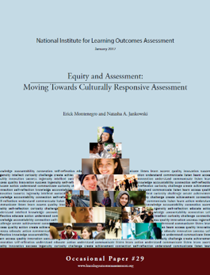
Equity Conversation Overview
Our student population is increasingly diverse
We know that in other areas of the institution, support needs differ by student populations
We don’t talk about it in assessment
We equate fairness with equity and limit the types of learning demonstrations we accept related to learning outcomes
Equity of process or equity of results?

Slide 17
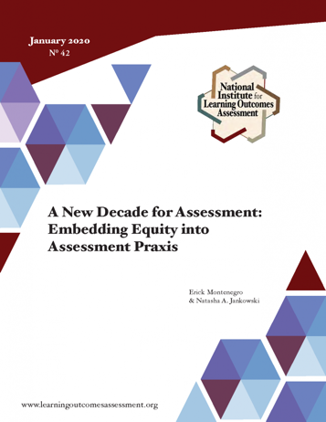
Equity Discussions
Notes:
But, before we get into discussions on the readings we need to do a bit of level setting- so there are a wide range of equity discussions

Slide 18
WHAT DOES “EQUITY-MINDED ASSESSMENT” ENTAIL?
Check
Check biases and ask reflective questions throughout the assessment process to address assumptions and positions of privilege
Use
Use multiple sources of evidence appropriate for the students being assessed and assessment effort
Include
Include student perspectives and take action based on perspectives
Increase
Increase transparency in assessment results and actions taken
Ensure
Ensure collected data are meaningfully disaggregated and interrogated
Make
Make evidence-based changes that address issues of equity that are context specific

Slide 19
Equitable Assessment
At its core, equitable assessment calls for those who lead and participate in assessment activities to pay attention and be conscious of how assessment can either feed into cycles that perpetuate inequities or can serve to bring more equity into higher education.

Slide 20
Infusing Equity in Assessment

Slide 21
Equity and Assessment
Process Implemented
Doing of the Process
Methods
Analysis
Policies
Decision Making
Action
Notes:
And equity and assessment is being examined in every facet of the assessment process

Slide 22
What would assessment look like if it was a vehicle for equity?
Notes:
Leading to the current national discussion on what assessment could look like as a vehicle for equity

Slide 23
Transparency in Assignments
Transparency in Learning and Teaching: https://tilthighered.com/
Purpose
Skills you’ll practice by doing this assignment
Content knowledge you’ll gain from doing this assignment
How you can use these in your life beyond the context of this course, in and beyond college
Task
What to do
How to do it (Are there recommended steps? What roadblocks/mistakes should you avoid?)
Criteria
(Are you on the right track? How to know you’re doing what’s expected?)
Annotated examples of successful work
(What’s good about these examples? Use the checklist to identify the successful parts.)
Notes:
How does this relate to equity – the point about having people be told that their learning doesn’t count over time in every course is a great way to lost students, but also, transparency in design closes equity gaps

Slide 24
Questions for Assignment
What learning outcomes will students demonstrate with this assignment? How does it need to be modified to better align with the learning outcomes of interest?
How does the assignment align with the evaluative criteria? Are there mixed signals sent to students?
Thinking about the assignment from the point of view of students, what questions or suggestions do you have?
How does this assignment allow for flexible options, alternative demonstrations, and/or culturally responsive demonstrations of learning?
How does this assignment need to be modified or adjusted to reflect current faculty and student circumstances and situations?
What unnecessary constraints, if any, may need to be removed to accommodate learning in a global pandemic crisis?
Notes:
Focused on questions – and can include a focus on equity questions in assignments

Slide 25
Having Hard Talks
How do we think about our responsibility for minority student outcomes?
How do we think about equity?
How do we know who benefits from the initiatives, innovations, and programs that we are so proud of?
How ought we assess to be responsive to minority students?
How do the assumptions we make about our students disadvantage them?
How do best practices take race and equity into account?
~Bensimon, 2012

Slide 26
Assumptions
Most of the standardized measures and theories we utilize come from studies of white students in mostly white institutions
We value certain demonstrations of learning over others, and in this way, we limit student demonstrations and privilege certain approaches.
We do not value narrative or personal experience in the same way for institutional decision making as we do quantitative data.
Our students are experts of their own experience.

Slide 27
Give us your feedback on today’s program
Visit: srs.campuslabs.com
Connect ID: 6663
You do not need to provide your name, but add something in the name box

Slide 28
Resources

Slide 29
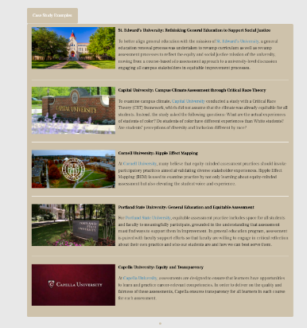
Notes:
There are institutional examples of how equity and assessment is currently being examined– and of note, they had to define what equitable assessment looked like for that institution - which requires a different lens on assessment – not one of compliance, of simply measurement and disaggregating data. So want to kick off with a brief primer on a definition of assessment and four philosophies of assessment.
Equity cases…responses, conversation on equity and assessment – more than just disaggregation – which is why we need to open with re-examining assessment as a collaborative act as infused in our culture with a growth mindset

Slide 30
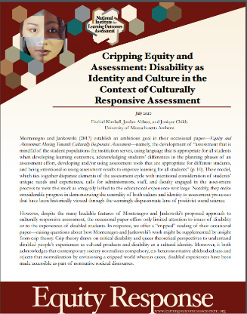

Slide 31
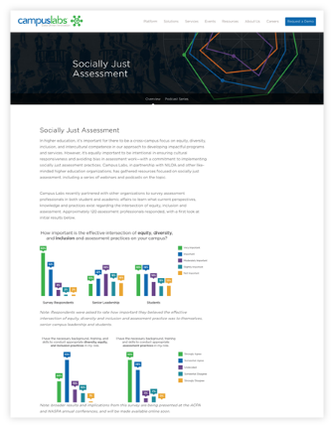
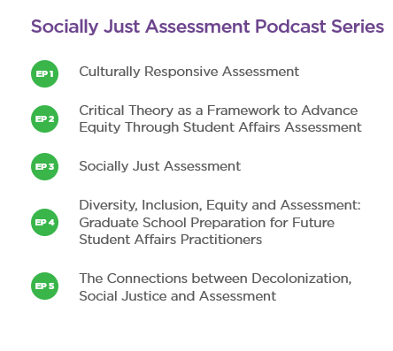
Notes:
Anne can speak to this

Slide 32
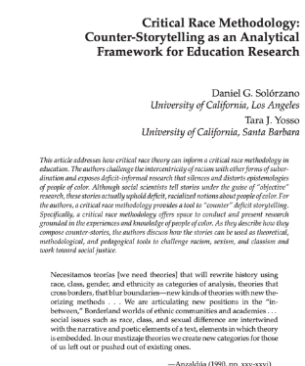
Reminders and Counter-Narratives

Slide 33
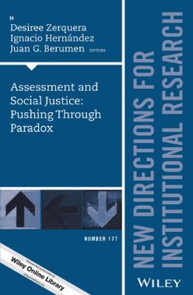
Notes:
Two pre-readings to frame the conversation and get the thinking going – and if you want more there is the journal issue as well

Slide 34
Equity Scorecard
https://cue.usc.edu/tools/the-equity-scorecard/

Slide 36
Philosophies of Assessment
Teaching and Learning
Measurement
Compliance/Reporting
Student-Centered
https://www.learningoutcomesassessment.org/wp-content/uploads/2020/05/Philosophy-Activity.pdf
Notes:
So – what are the lenses at play in your work here – this is an activity taken from Nan Traver’s work on PLA to help us explore and figure it out

Slide 37
Notes:
Go ahead and first, go through and complete the form yourself and tally up yours Add up numbers to see where you fall in the groupings and talk about how unlikely will be in only one It is 0-4, N/A is 0, you can do .3 or whatever but you have to add at the end

Slide 38
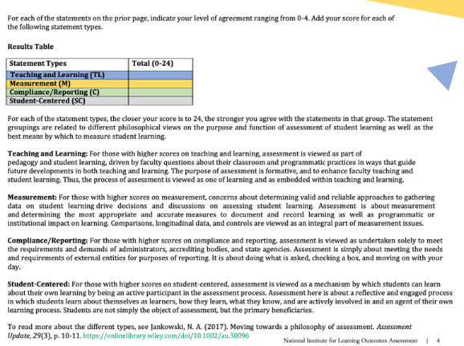
Notes:
Are there ways you think about assessment that aren’t on this list or in these groupings? Share those out

Slide 39
https://www.confederationcollege.ca/tlc/indigenous-learning-outcomes

Slide 40
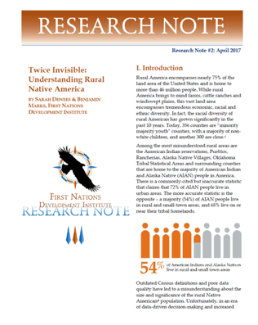

Slide 42
Student Involvement

Slide 43
Otter Ideas and Questions?

Slide 44
Mark your calendar for our next event

