Slide 1

Community Check-Ins and Updates
Dr. Natasha Jankowski, Executive Director, National Institute for Learning Outcomes Assessment (NILOA)
Research Associate Professor, UIUC
@njankow
@NILOA_Web

Slide 2
WELCOME
What’s the series about?
How will our time together today flow?
In case you are wondering:
  Slides will be shared
  This is being recorded and will be shared
  You can keep the convo going on twitter with #NILOAwebinar
  And #AssessmentMusic (more on that in a minute)
To begin: Share something about yourself in the chat or show the camera your child who will join us or pet who will pop in ☺

Slide 3
#AssessmentMusic
Song to Mourn Loss of What We Thought This Semester Would Be: Kronos Quartet – Vasks: String Quartet #4: Meditation
Song to Inspire Hope (recommend start at 3:06-5:20): Holst: The Planets: IV Jupiter the bringer of jollity / Bernstein · New York Philharmonic
Song to Remind us of What Comes from a Fire…the Rebirth: Firebird Suite: Stravinsky – Finale, London Symphony Orchestra with Leopold Stokowski
If You Just Need to Breathe: Yo-Yo Ma: Bach Cello Suite No. 1 in G Major, Prelude

Slide 4
Point One
This is not a test of online education.
This is a triage situation of survival entailing an emergency move to distance or remote instruction.
People are in crisis mode (still) and definitely experiencing information overload. Maybe try recording a video message instead of sending another email ☺
We can learn from other situations with displaced students such as Hurricane Katrina: https://diverseeducation.com/article/170735/

Slide 5
Point Two
Compassion not compliance should drive decisions at this time. If we lose students to stress because of compliance decisions we made, we are doing it wrong.
We are in uncharted territory and we should not wait for guidance, but drive guidance based on needs. In other words, don’t let the existing guidance make your decisions as things change and then you have to keep changing – do right by students and then justify how it aligns. These are unprecedented times and not something to be driven by compliance.
For instance, due to concern on Pass/Fail and SAP, it was an area included in the stimulus package. But if you are concerned about Pass/Fail, there is a google doc of what other institutions are doing and you can follow #Passfailnation

Slide 6
Point Three
Listen to students. Learning is compromised from the student perspective. Focus on learning, not data collection.
We need different types of assignments and demonstrations. And it might be an incomplete.
Be flexible on deadlines. Students are concerned about grades, completing classes, that they are going to fail. Help them focus on what really matters from the course – the learning outcomes.
It’s not about learning online, it’s about learning in a global pandemic crisis.
Involve students in asking how they want to be assessed

Slide 7
Assessment
Arguments to consider before heading straight into proctoring exams
Consider how to capture the learning already done in the term/semester and the power of reflection assignments
Return to assessment basics – in this course, what is most important for students to learn and what is a well aligned assignment?
The data from this semester will be full of noise, it is asterisks all the way down – everyone has that. How much learning happens in such stressful times? When you are also homeschooling? Maybe lost your job? This is not good longitudinal data.
The focus of program assessments right now should be broadly on whether students are making progress on the most important learning outcomes for the program. It’s ok to postpone program reports.

Slide 8
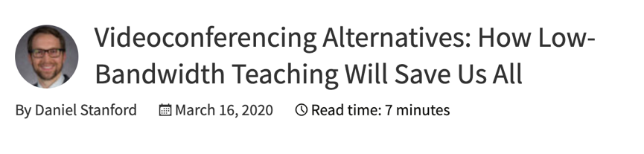
There are concerns about student access to adequate Internet.
Some institutions are providing Internet access in parking lots, but there are also access options of providers providing free two months of internet access – explore what is in your area
Do not assume students have the bandwidth, access, data plans, or software - plan for lower bandwidth options like collaborative docs

Slide 9

Student Affairs Resources
Student Affairs Assessment Leaders: http://studentaffairsassessment.org/
Council for the Advancement of Standards: https://www.cas.edu/

Slide 10

e-Mail your questions about anything related to teaching online to askanexpert@teachonline.ca or submit your question online on teachonline.ca. and receive a response within 2 business days. Questions and answers will be posted for quick reference.

Slide 11
Compilation Resources
National Conference of State Legislatures is keeping track of higher education responses to COVID-19
We are maintaining a Google doc of resources
AALHE has a slack channel with special interest groups
Quality Matters Emergency Remote Instruction Checklist and accompanying video

Slide 12


Keep Discussing Online
#NILOAwebinar
#AssessmentMusic
Join Our Email List: learningoutcomesassessment.org/joinemail/
@NILOA_web
@LearningOutcomesAssessment

Slide 13
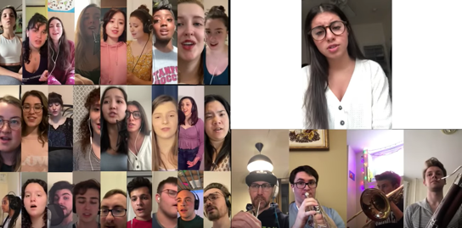
A happy note to leave you with
Video from virtual music group from students

